Slide 1

HEART SCORE:
a powerful risk stratification tool for the prediction of major adverse cardiac events (MACE)

Slide 2
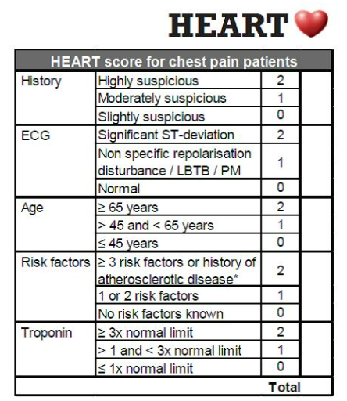
INTRODUCTION
In the United States, a person dies every 34 seconds from cardiovascular disease. It is the leading cause of death for people of most racial and ethnic groups, regardless of gender.
The HEART is a scoring system developed in 2008 for patients presenting with chest pain at the emergency department.
HEART score was designed to risk stratify patients with undifferentiated chest pain, not those already diagnosed with acute coronary syndromes (ACS).
The HEART score has been validated in several research studies and has proven to be a powerful, easy, and above all practical tool to separate patients into low, medium, and high-risk groups of developing acute coronary syndrome (ACS).
Patients receive a score on a scale of 0‒10. They were assigned 0, 1, or 2 points toward 5 different criteria namely:
Patient’s Medical History,
ECG abnormalities,
Age,
Risk factors include:
Diabetes mellitus,
Hypertension
Chronic smoking for more than 90 days
Diagnosed hypercholesterolemia,
Hereditary coronary artery disease (CAD),
Obesity (BMI more than 30),
History of significant atherosclerosis
Troponin levels (normal being 0 to 0.04 nanograms per milliliter).

Slide 3
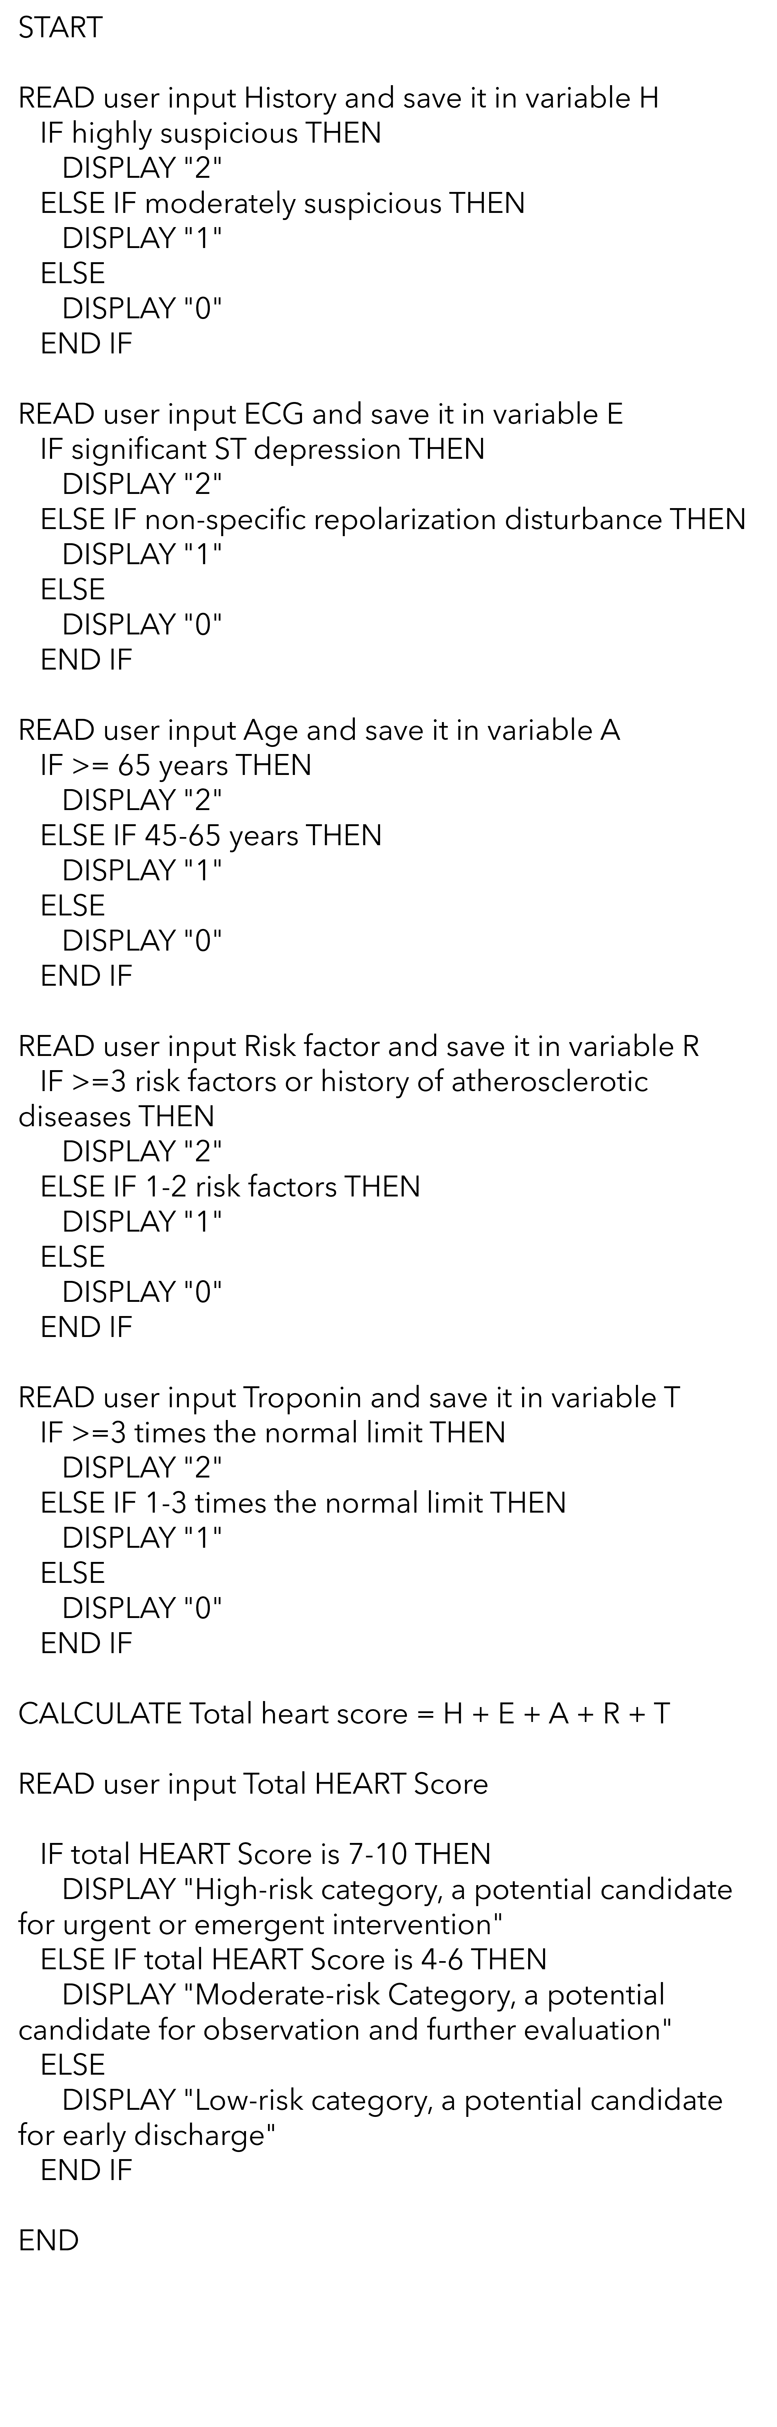
PSEUDOCODE

Slide 4
SCOPE
Patients scoring 7 or higher have a 50% chance of developing myocardial infarction (MACE) within 6 weeks following the presentation. The high-risk group required either coronary artery bypass graft surgery (CABG) or Percutaneous transluminal coronary angioplasty (PTCA) as an emergency medical intervention to save their lives.
Patients scoring between 4-6 had a 20 % chance of developing MACE whereas Patients who had scores between 0-3 had just a 2% chance of MACE development.
With the HEART score, it is immediately clear which patient is eligible for discharge without additional tests or emergency invasive procedures thereby helping to avoid unnecessary healthcare expenditure.
The HEART score should be used in patients aged ≥ 21 years who present with symptoms suggestive of ACS.
It should not be used if there is a new ST-segment elevation ≥ 1 mm (patients requiring immediate treatment), or if there is hypotension, life expectancy < 1 year, or if the clinician identifies noncardiac medical, surgical, or psychiatric illness requiring admission.
STRENGTHS
HEART score accurately diagnoses and predicts future MACE (major adverse cardiovascular event) in acute chest pain patient
HEART score was found to be much more useful and superior in clinical practice when compared to other better-known risk scores like GRACE, TIMI, and EDACS.
Simple and practical decision-making tool in ED.

Slide 5
LIMITATIONS
Most low-risk patients are misclassified
The limitation of the HEART score is its suboptimal ability to detect most low-risk patients (HEART score ≤ 3)
Low risk is “not” no risk
Patients presenting with acute chest pain whose HEART score ≤ 3 are generally considered low risk and in most circumstances can be discharged from ED for outpatient evaluation. In the original report, MACE occurred in 2.5% of the subjects with score ≤ 3.
Conventional Vs Latest Troponin Assays
Conventional troponin assays were used initially. The fifth-generation ultra-high sensitivity troponin assay currently used is up to 100-fold more sensitive. Consequently, some of the subjects previously classified as low risk may fall into a higher-risk category potentially impacting the predictive ability of HEART score for future MACE.
Incorporating an ultra-high sensitivity troponin assay into practice and as a component of the HEART score could potentially have a negative impact on the HEART score being a useful risk stratification tool for identifying patients for early discharge.
Interpreter’s biases
The distinction between nonspecific and ischemic ST changes on ECG is not clearly explained. Hence it is subjected to an observer’s interpretation.
For instance, studies have shown that more experienced providers may score patients higher than newer practitioners while cardiologists may be likely to score borderline-risk patients lower than ED physicians. History, ECG, and Chest pain description had the worst agreement among doctors and cardiologists.
Algorithm considers all risk factors equal, but this might not be the case.
It omits some important risk factors, such as sex assigned at birth.

Slide 6
FUNCTIONAL GOALS
HEART SCORE IMPROVED THE QUALITY OF HEALTH/CLINICAL OUTCOMES [9]
Helped to reduce diagnosis-related medical errors
Based on the different risk levels, telehealth consultations were provided for patients
Management of chronic disease group through positive reinforcement and regular follow-ups
Patient communication and education about the individual’s health condition
Heart scores proved to increase the quality of care and save money if properly implemented. HEART score potentially minimized health care disparities among different patient populations in the ED with chest pain.
HEART SCORE IMPROVED THE PRODUCTIVITY OF PHYSICIANS [8]
Effective communication among physicians at ED, in-patient, and ambulatory services helped to avoid physicians’ inter-rater variability.
Performance evaluation of healthcare workers using key metrics like patient retention, satisfaction rates and decreased wait time.
Adopting the right technology for visitor management, e- medication management, and connecting with the patients remotely.
Training the team on new technology and tools to read ECG abnormalities,and assess troponin levels.
Heart score was potentially useful as an adjunct to physician medical decision-making since it identified the risk group for short-term adverse outcomes resulting from ACS. HEART score aided cardiologists with recommendations for disease management.
HEART SCORE IMPROVED THE SAFETY OF PATIENTS [9]
Adopting uniform standard procedures like HIPAA.
Coordinated efforts among different care providers.
Diagnosis of health concerns as carefully and quickly as possible
Enhanced compatibility of health records
Heart score allowed for the safe discharge of a considerable number of patients with scores between 0-3, effectively reducing downstream testing. The HEART score helped to isolate patients with a greater risk of having a major adverse cardiac event (MACE) within the following 6 weeks.
HEART SCORE SUPPORTED GREATER INVOLVEMENT OF PATIENTS IN THEIR OWN HEALTHCARE [7]
Heart score through patient engagement resulted in
Increased patient satisfaction and trust,
Improved Patient Knowledge & Understanding,
Greater physician-patient relationship,
Reduced patients’ anxiety and emotions and Patients took better responsibility for their health outcome

Slide 7
ISSUES TO CONSIDER WITH INTEGRATION [10]
Privacy and security concerns
Difficult to estimate the value of HIE
Increased cost
Improves quality of care but makes no promise of efficiency
OUTSIDE THE FIREWALL

Slide 8
CONCLUSION
As Leonardo Da Vinci stated, “Simplicity is the ultimate sophistication”. Since 2008, the HEART score has been one of the most, commonly utilized tools worldwide of all the risk stratification tools available for acute chest pain. Over the years, a few modifications and variants have been reported (such as modified HEART Score / HEART Pathway).
The physician should consider the information provided in the HEART score in addition to clinical judgment in the ultimate determination of management strategy in the adult chest pain patient suspected of ACS. A much simpler tool with just 3 criteria namely the History of the patient, Troponin levels, and ECG findings is sufficient since only these factors are independently associated with the outcome. So far, only retrospective studies have evaluated heart scores, more prospective studies with Heart score application in clinical settings are needed.
BIBLIOGRAPHY
Brady, W., & de Souza, K. (2018). The HEART score: A guide to its application in the emergency department. Turkish Journal of Emergency Medicine, 18(2), 47-51.
https://cardiologyres.org/index.php/Cardiologyres/article/view/1432/1358
https://www.heartscore.nl/
https://www.ebmedicine.net/media_library/files/Cardiovascular-NSTEMI-CD.pdf
https://www.medicalnewstoday.com/articles/heart-score#concerns
Tran, L., Ervin, C., Mickalis, M., Weigle, R., Sampath, R., & Isserman, S. (2020). Appropriate Utilization of the HEART Score Saves Money: A Community Hospital Perspective. Arteriosclerosis, Thrombosis, and Vascular Biology, 40(Suppl_1), A273-A273.
https://ac-health.com/5-benefits-of-patient-engagement/
https://zipline.io/post/employee-productivity-in-healthcare
https://healthadministrationdegree.usc.edu/blog/7-ways-to-improve-patient-outcomes/
https://www.ncbi.nlm.nih.gov/pmc/articles/PMC4288063/

